Slide 1

Computational Neurobiology
Week 6 Workshop

Slide 2
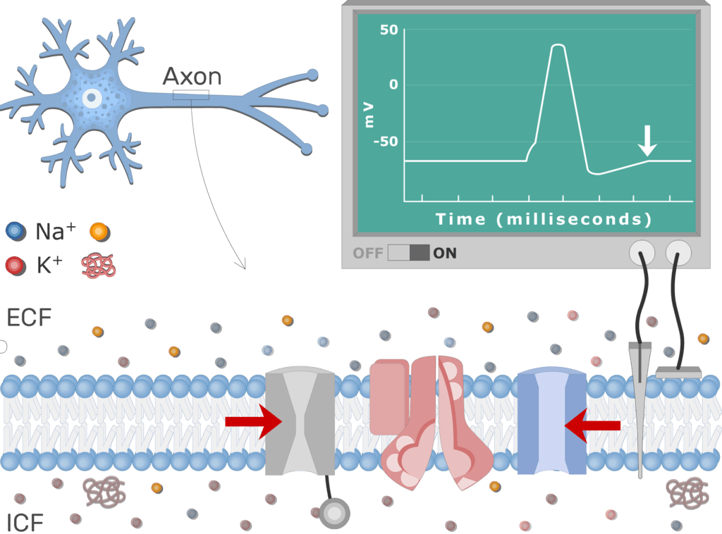
Hodgkin and Huxley aimed to decipher how the membrane conductance changes with time and voltage
Notes:
Hodgkin’s and Huxley’s goal was to build a model that explains how action potentials are created and propagated.
Met with challenges:
Had to decipher roles of Na+ and K+
Had to understand how membrane conductance changes with changes in time or voltage
Came up with this approach:
Used voltage clamp techniques to isolate and measure specifical ionic currents
Create mathematical models to describe ion channel dynamics
In the end, they created a landmark model that explained action potentials using nonlinear differential equations — forming the basis of computational neuroscience!
Goal: Build a quantitative, mechanistic model to explain how action potentials are generated and propagated.
Challenges:
Untangle the roles of Na⁺ and K⁺ in voltage changes.
Understand how membrane conductance changes over time and voltage.
Approach:
Use voltage clamp techniques to isolate and measure specific ionic currents.
Create mathematical equations to describe ion channel dynamics (before "ion channels" were even visualized).
Outcome: A landmark model that explained action potentials using nonlinear differential equations — forming the basis of computational neuroscience.

Slide 3
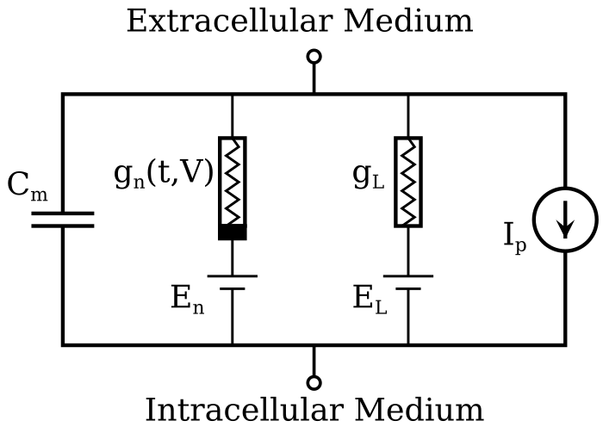
Circuit Components - Physics Perspective
Notes:
Capacitor
Cm refers to lipid bilayer
Initially acts like a thin wire, once charge accumulates, begins to act more like an open circuit
Battery
“E” → electrochemical gradients
Power source, drives current across resistors, capacitors, etc
Current Source
Ion pumps / exchangers
Conductances
Gn, Gl → voltage gates & leak ion channels
Reduces current flow

Slide 4
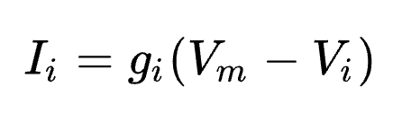
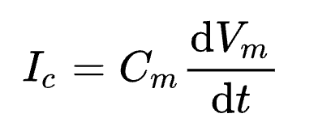
Understanding our Circuit Model
Application of Ohm’s Law, V = IR
Relating Capacitance and current
Analyzing total current flow

Slide 5
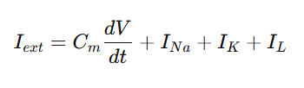


How did they derive the network?
Total membrane current:
Each current:
Each gate variable:
Notes:
First, we have the membrane voltage equation, which describes how voltage changes over time due to capacitive and ionic currents. It’s modeled as a circuit, as we just discussed
Ion-specific conductances (I_{Na}, I_{K}, I_{L}) are like variable resistors
Sodium channel
Potassium channel
Leak channel
Modeled each ionic current as a conductance times the voltage difference across the membrane.
But they realized the sodium and potassium conductances (g_{Na} and g_{K}) weren’t constants — they varied with voltage and time
To model each ionic current, they found Na⁺ conductance depends on 3 "activation gates" (m) and 1 "inactivation gate" (h), while K⁺ conductance depends on 4 activation gates (n).
To capture this, they introduced empirical gating variables:
m: Na⁺ activation
h: Na⁺ inactivation
n: K⁺ activation
Found this:
g_{Na} = g_{Na,max} · m³ · h
g_{K} = g_{K,max} · n⁴
In the end, three differential equations form the network
α_{n}(V) and β_{n}(V) are voltage-dependent rate functions that were experimentally derived
One for membrane voltage, three for the gating variables (m, h, n). The final system could be solved numerically to simulate action potentials.
I_{ext} combines each current. And then they have the gate variable equations. And together, they make a set of 4 equations that can be used to simulate of realistic action potentials.
Interesting video:
https://youtu.be/_dIb6WLY6zI?si=kjOghyZBxfvTcgJ1
Not good for slides because its long and a bit disorganized (sounds like a teacher and a student teacher) but if someone wants to learn more it’s really interesting. Very mathy

Slide 6


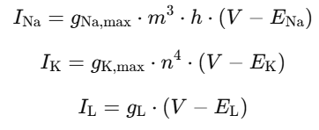
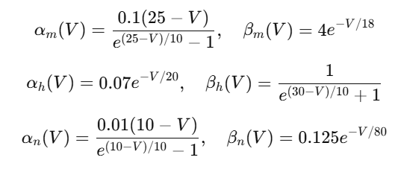
Notes:
Membrane voltage equation and ionic currents equations (left)
Gating variable (right)

Slide 7
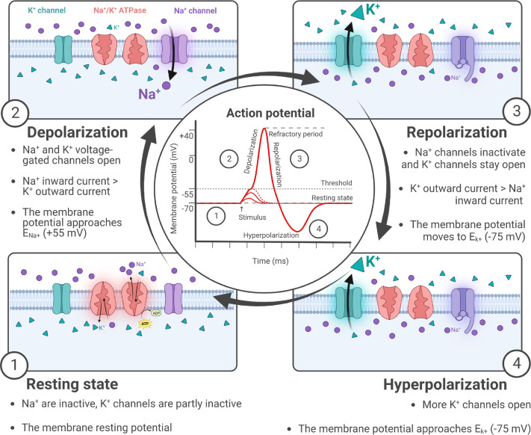
Spike Shapes

Slide 9
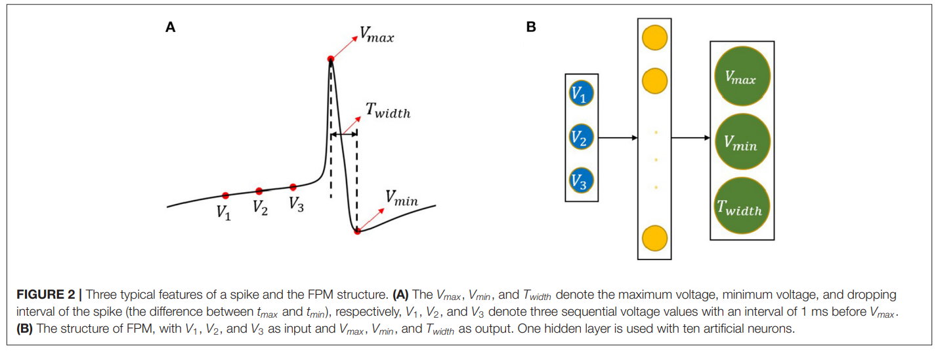
Spike Shapes
https://www.frontiersin.org/journals/computational-neuroscience/articles/10.3389/fncom.2021.800875/full

Slide 10
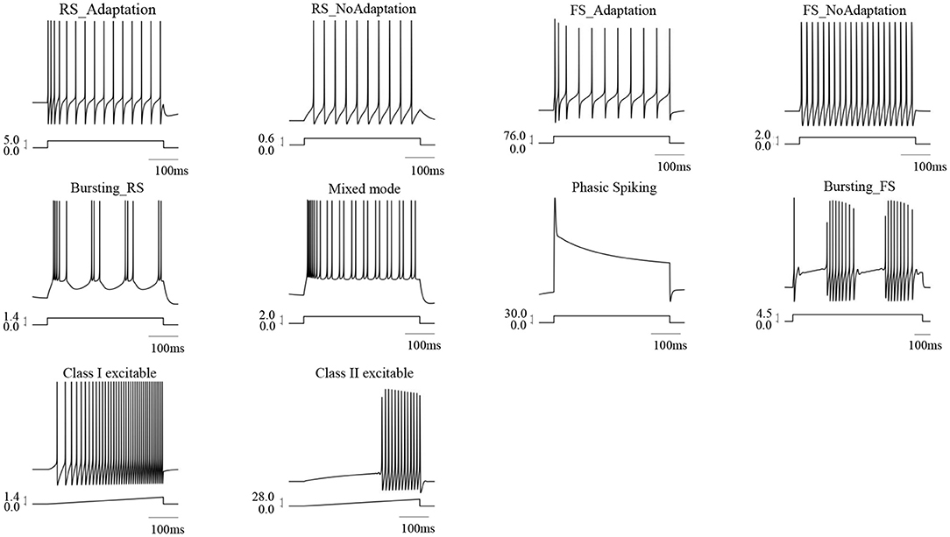
Spike Shapes

Slide 11
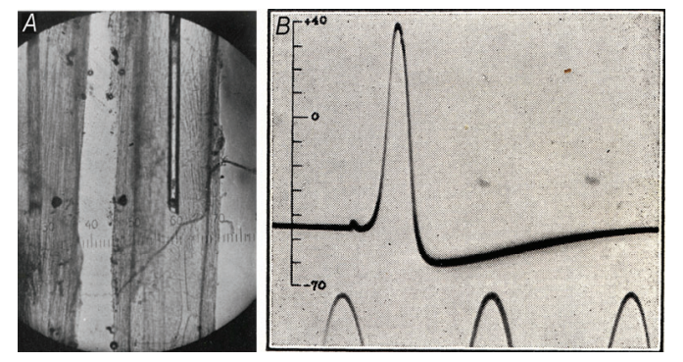
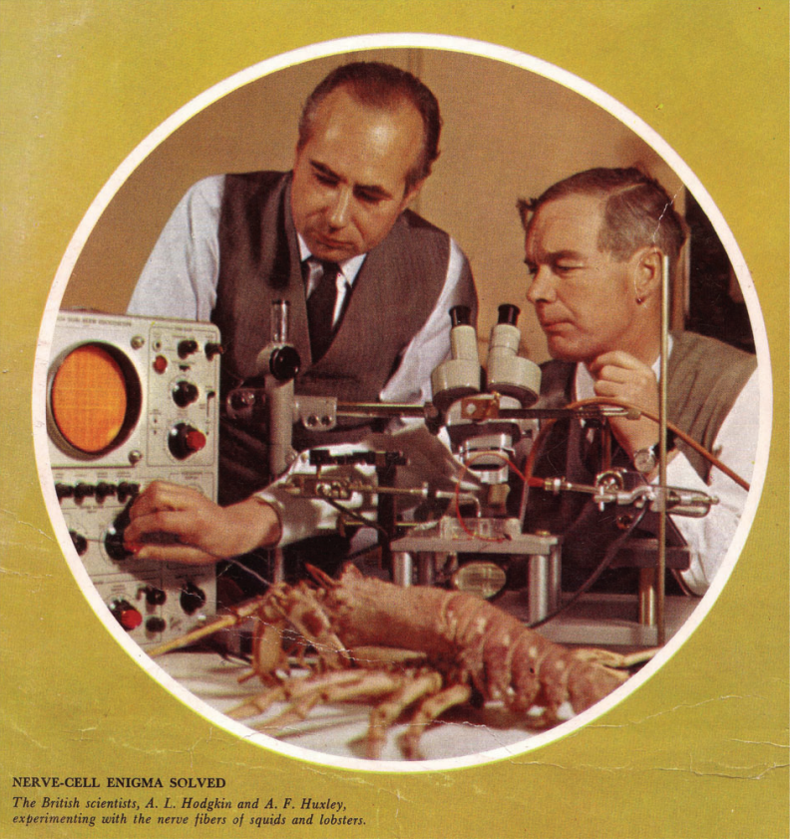
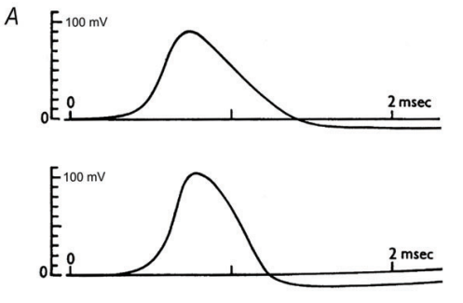
Nobel Prize Winner
Alan Lloyd Hodgkin and Andrew Fielding Huxley awarded Nobel Prize in 1963 for explaining how action potentials are initiated and propagated in neurons
Used voltage clamp technique on the squid giant axon
Gave equations modeling ionic conductances across the neuronal membrane
https://pmc.ncbi.nlm.nih.gov/articles/PMC3424716/pdf/tjp0590-2571.pdf

Slide 12
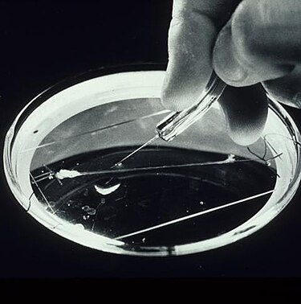
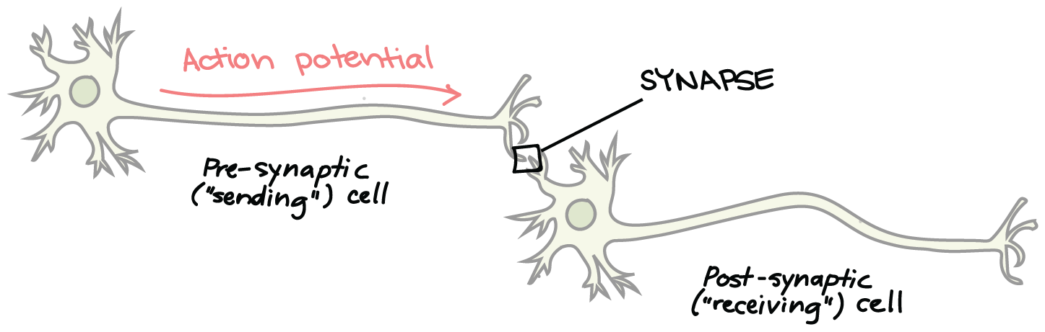
The squid giant axon helps lead to great discoveries in action potentials of a membrane
Notes:
Alan Hodgkin and Andrew Huxley, 1952
Tried to explain how action potentials propagate in the squid giant axon
Helps control jet propulsion in squid
Game real-time access to how a neuron works
Large diameter extremely helpful—allowed them to insert voltage clamp electrodes inside the lumen of the axon
Already knew:
Neurons transmit electrical signals (unlike chemical), didn’t know how
Resting membrane potential ~ -70 mV
Action potential of brief electrical spikes. Didn’t know how these happened
Researchers hypothesized that ion movement (Na+ and K+ specifically) across membranes played a role in action potentials
Neuron Basics: Scientists knew neurons transmit electrical signals (other than chemical), but the mechanism was unclear.
Resting Potential: It was established that neurons maintain a resting membrane potential (≈ -70 mV).
Action Potentials: These brief electrical spikes could be recorded, but their origin was a mystery.
Ionic Hypothesis: Researchers suspected ion movement (especially Na⁺ and K⁺) across membranes played a role in action potentials.
The Giant Squid Axon:
Used due to its large size (~1 mm diameter), ideal for inserting electrodes and performing voltage clamp experiments.
Provided unprecedented access to real-time electrical activity inside a neuron.

Slide 13
What we can learn from network
Represent neurons as electrical circuits (ion channels resistors, membrane capacitor, driving forces as batteries)
Translating differential equations shows how Na⁺ and K⁺ conductances shape the action potential
Shape, duration, and frequency of spikes depend on voltage gated channel kinetics
Model transitions between resting state, threshold, and firing behavior as observed in biological neurons

